Slide 1
Secure Data Hiding in Image Using Steganography
CAPSTONE PROJECT
Presented By:
Student Name : BHAVANI B
College Name & Department : CAUVERY COLLEGE FOR WOMEN, TRICHY & BCA

Slide 2
OUTLINE
Problem Statement
Technology used
Wow factor
End users
Result
Conclusion
Git-hub Link
Future scope

Slide 3
Problem Statement
The problem is to implement a secure method for embedding and extracting secret messages in images. The encryption process hides a message within the pixel values of an image, and the decryption process retrieves the message using a password for authentication. The original pixel values are stored separately to restore the image after extracting the hidden message. This ensures both message security and image integrity during the process.

Slide 4
Technology used
The code utilizes the following technologies:
Python: Programming language used for implementing encryption and decryption functions.
OpenCV (cv2): Library for image processing, used to read, modify, and save images.
Pickle: Library for serializing and deserializing data, used to store and retrieve original pixel
values.
Text files: Used for storing the password for secure decryption.

Slide 5
Wow factors
Message Embedding in Pixels: Hides the secret message within the image's pixel values for security.
Password Protection: Ensures authorized access to the hidden message via password authentication.
Image Restoration: Restores the original image after message extraction, preserving its integrity.
Custom Compression: Adjusts image compression based on format (PNG/JPEG) to maintain quality.
The standout features of this project are:

Slide 6
End users
The end users of this project are:
Individuals: Users seeking to securely hide messages within images for personal privacy.
Businesses: Organizations needing encrypted communication for sensitive data transmission.
Security Enthusiasts: Users interested in exploring encryption techniques for data protection.
Developers: Developers working on projects involving secure data storage and transmission via images.

Slide 7
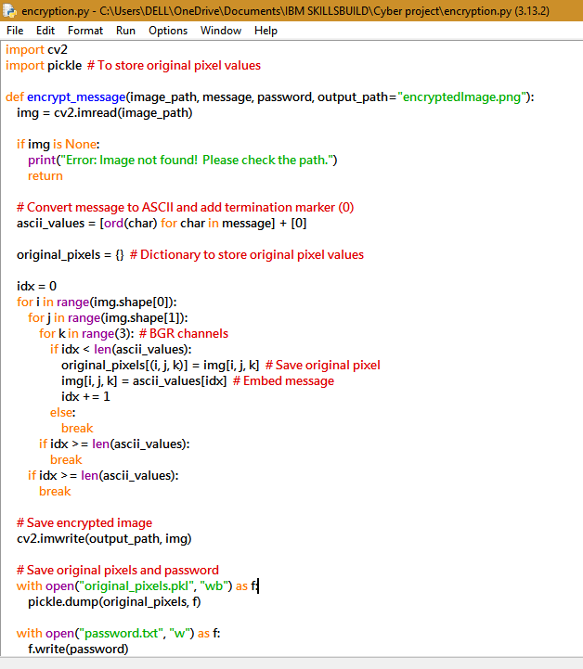
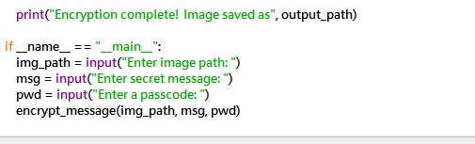
Results
ENCRYPTION CODE

Slide 8
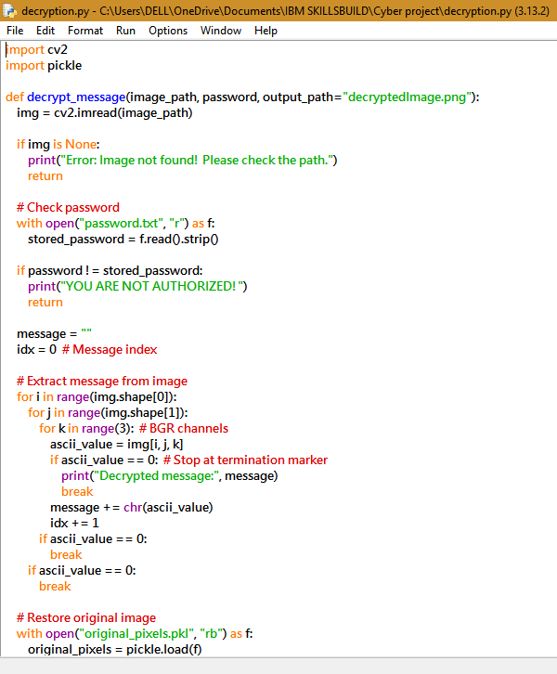
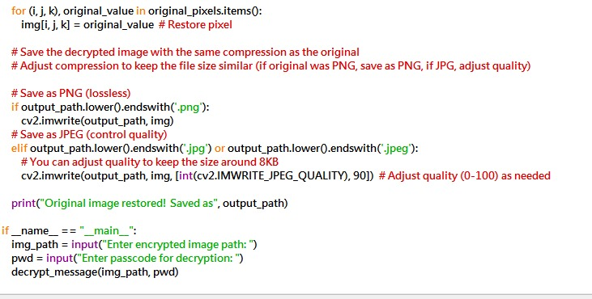
DECRYPTION CODE

Slide 9
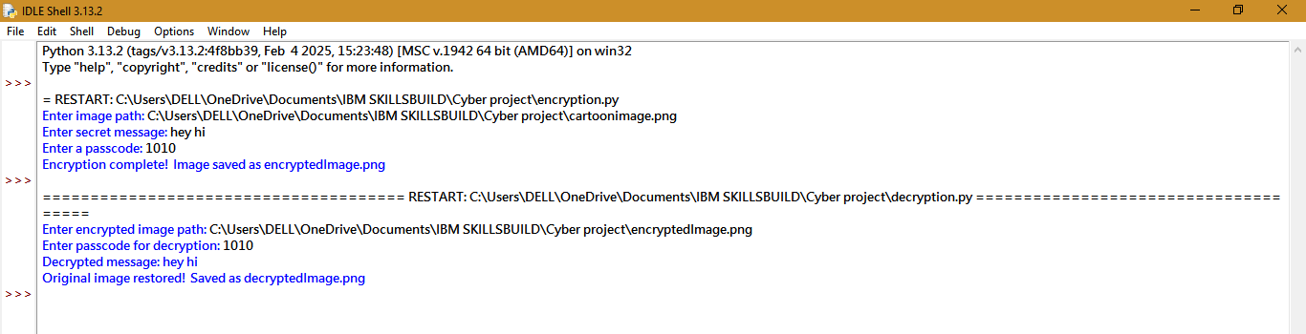
OUTPUT

Slide 10
Conclusion
This project provides a secure and efficient method for hiding and retrieving messages within images while ensuring image integrity. With password protection and original pixel restoration, it enhances data confidentiality. It is useful for secure communication, privacy protection, and digital forensics.

Slide 11
GitHub Link
https://github.com/Bhavani-1010/CYBER-PROJECT.git

Slide 12
THANK YOU

